Slide 1
Class 설계서
7조 Turkey

Slide 2
변경 이력
일자 | 버전 | 변경 내역 | 작성자
2017.05.17 | V0.1.0 | Class 설계서 등록 | 이연재
2017.05.24 | V0.1.1 | Subject관련 설계서 수정 | 김희애
2017.05.24 | V0.2.0 | DataBase클래스 추가 | 김희애
2017.05.25 | V0.3.0 | Todo관련 설계서 등록 | 김자훈
2017.05.25 | V1.0.0 | Class Diagram 등록, 초안 | 신정길
2017.05.26 | V1.0.1 | 오타 수정 | 구소연
2017.06.05 | V2.0.0 | 보이기/숨기기 기능 설계 | 이연재

Slide 3
Main()
public static Intro introclass
public static void main(String args[])

Slide 4
Intro()
private JPanel contentPane private Intro thisIntro Private SubjectManage subjectmanage1 Private TodoManage todomanage1 JButton btnSubjectMange JButton btnTo
public Intro() public void actionPerformed(ActionEvent e)

Slide 5
SubjectManage()
private Intro introclass private JPanel contentPane private SubjectManage thisSubjectManage private JTalbe table private DefaultTableModel TableModel Private Database database JButton btnAdd JButton btnChange JButton btnDelete JButton btnBack JScrollPane scrollPane | Private String[] SubjectColumnNames
public SubjectManage(Intro introclass_parm) public void actionPerformed(ActionEvent e) public void SubjectTable()

Slide 6
SubjectAdd()
private SubjectManage subjectmanageclass private JPanel contentPane private SubjectAdd thisSubjectAdd private JTextField txtSubject private JTextField txtProf private DataBase database JButton btnAdd JButton btnBack JLabel lblSubject JLabel lblProf JLabel lblYearSemester JLabel lblDay JLabel lblStart JLabel lblEnd | JComboBox cbStartAm JComboBox cbStartHour JComboBox cbStartMinute JComboBox cbEndAm JComboBox cbEndHour JComboBox cbEndMinute JComboBox cbSemester JYearChooser ycYear JButton btnMon JButton btnTue JButton btnWed JButton btnThu JButton btnFri JButton btnSat JButton btnSun
public SubjectAdd(SubjectManage subjectmanage_parm) public void actionPerformed(ActionEvent e) public void mouseClicked(MouseEvent e)

Slide 7
SubjectChange()
public SubjectElement SubjectElement private JPanel contentPane private SubjectManage subjectmanageclass private SubjectChange thisSubjectChange private JTextField txtSubject private JTextField txtProf private DataBase database JButton btnChange JButton btnBack JLabel lblSubject JLabel lblProf JLabel lblYearSemester JLabel lblDay JLabel lblStart JLabel lblEnd | JComboBox cbStartAm JComboBox cbStartHour JComboBox cbStartMinute JComboBox cbEndAm JComboBox cbEndHour JComboBox cbEndMinute JComboBox cbSemester JYearChooser ycYear JButton btnMon JButton btnTue JButton btnWed JButton btnThu JButton btnFri JButton btnSat JButton btnSun
public SubjectChange(SubjectManage subjectmanage_parm, int selectedRow) public void actionPerformed(ActionEvent e) public void mouseClicked (MouseEvent e)

Slide 8
TodoManage()
private Intro introclass private JPanel contentPane private TodoManage thisTodomanage private JTable table JButton btnAdd JButton btnChange JButton btnDelete JButton btnBack JScrollPane scrollPane JButton btnHideShowCompleted
public TodoManage(Intro introclass_parm) public void actionPerformed(ActionEvent e) public void UpdateTable_HideShowCompleted() public void SelectUpdateTableMethod()

Slide 9
TodoAdd()
private JPanel contentPane private TodoManage todomanageclass private TodoAdd thisTodoAdd private JTextField txtTodo private DataBase DataBase public TodoElement TodoElement JButton btnAdd JButton btnBack JButton btnAmPmDeadline JButton btnAmPmDueDate JTextField txtTodo | JCalendar JCalendarDueDate JCalendar JCalendarDeadline JComboBox cbSubject JComboBox cbDeadlineHour JComboBox cbDueDateHour JComboBox cbDeadlineMinute JComboBox cbDueDateMinute JCheckBox checkImportance JLabel lblToDo JLabel lblSubject JLabel lblDeadline JLabel lblNewLabel_1 JLabel lblImportance
public static void AM_PM(Calendar calendar, JButton btn) public TodoAdd(TodoManage todomanage_parm) public void actionPerformed(ActionEvent e)

Slide 10
TodoChange()
private JPanel contentPane private TodoChange thisTodoChange private TodoElement TodoElement private DataBase DataBase JLabel label JLabel lblTodo JLabel lblSubject JLabel lblDeadline JLabel lblimportance JLabel lblDueDate boolean Completed boolean Importance | JButton btnAmPmDueDate JButton btnAmPmDeadline JButton btnBack JButton btnChange JTextField txtTodo JComboBox cbSubject JCheckBox checkImportance JCheckBox checkCompleted JComboBox cbDeadlineHour JComboBox cbDeadlineMinute JComboBox cbDueDateHour JComboBox cbDueDateMinute JCalendar JCalendarDueDate JCalendar JCalendarDeadline
public TodoChange(TodoManage todomanage_parm,int selectedRow) public void actionPerformed(ActionEvent e)

Slide 11
SubjectElement()
public String name public String prof public String selectday public int starthour public String startminute public int endhour public String endminute public int year public String semester
public SubjectElement(String name, String prof, String selectDay, int startHour, String startMinute, int endHour, String endMinute, int year, String semester)

Slide 12
TodoElement()
public String Todo public String Subject public Calendar Deadline public Calendar DueDate public boolean Completed public boolean Importance
public void setTodoElement(String Todo, String Subject, Calendar Deadline, Calendar DueDate, Boolean Completed, boolean Importance)

Slide 13
Database()
public final String[] SubjectColumnNames public final String[] TodoColumnNames public final String[] Hour public final String[] Minute public final String[] Am public final String[] Semester private static DataBase database | Private String subjectmatrix[][] Private String SubjectName[] Private String [][] TodoMatrix Private TodoElement selectedTodoElement Vector<SubjectElement> SubjectElement Vector<TodoElement> TodoElement HashMap<Integer, Integer> HideHashMap public boolean Hide
public static DataBase getDataBase() public void SubjectAdd(SubjectElement Element) public void SubjectChange(SubjectElement Element, int selectedRow) public SubjectElement getSelectedSubject(int selectedRow) public void SubjectDelete(SubjectElement Element, int selectedRow) public String[][] MatrixSubject() public void TodoAdd(TodoElement Element) public void TodoChange(TodoElement Element, int selectedRow) public TodoElement getSelectedTodoElement(int selectedRow) public void TodoDelete(TodoElement Element, int selectedRow) public String[][] MatrixTodoElement() public String[][] MatrixHideShowCompleted() public int SizeofMatrix()

Slide 14
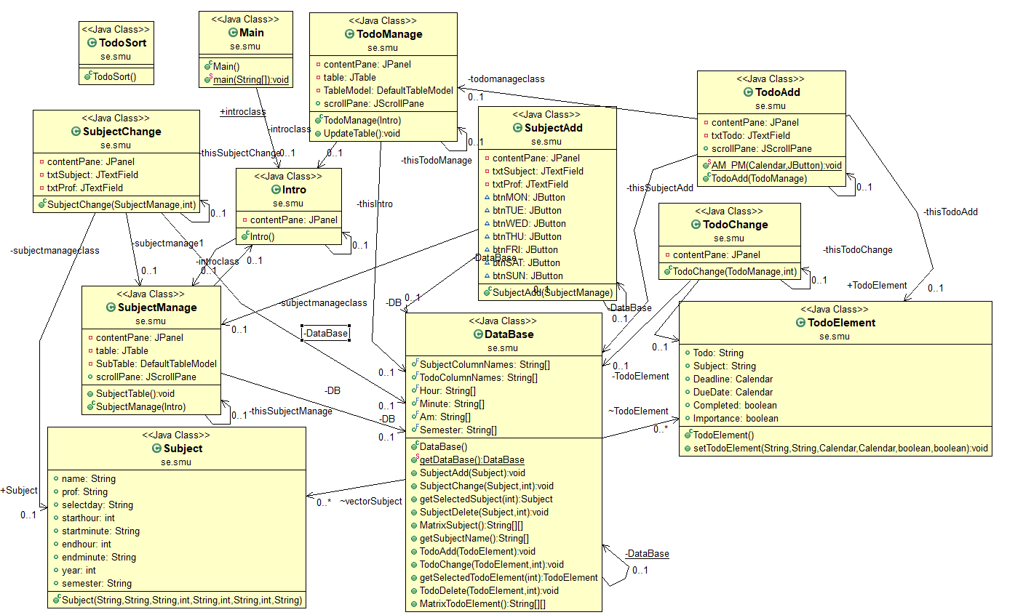
<Class Diagram>

